Slide 1
External Files
Tutorial #15

Slide 2
OBJECTIVE

Slide 3
Objective
You should walk away from this tutorial with an understanding of how to organize different files with code in them to produce a single web page.

Slide 4
TEXTPLANATION

Slide 5
Textplanation
Up until now, we’ve been stuffing every bit of code into our HTML files. HTML files are designed for it. That’s why there’s a script tag and a style tag. Because, ultimately, the browser has to look at everything together as a single entity in order for it to execute properly.

Slide 6
Textplanation
Consider this: You have this web site, which consists of several different HTML pages. Each page works independently, but they all share the same style and they use a lot of the same Javascript functions in order to make their features work.

Slide 7
Textplanation
What do you do?

Slide 8
Textplanation
Well, you can copy and paste the code from file to file or you can make a single CSS file and a single Javascript file and import them into every HTML file. This kind of thing saves programmers lots and lots of time. And programmers need that time so that they can come up with other ingenious programs.

Slide 9
Textplanation
And eat pizza.

Slide 10
Textplanation
And play video games.

Slide 11
Textplanation
A Javascript file can have any name, but must have the .js extension. Do not place any HTML or CSS inside of this file. It accepts Javascript code only.

Slide 12
Textplanation
A CSS file can have any name, but must have the .css extension. Do not place any HTML or Javascript inside of this file. It accepts CSS code only.

Slide 13
CONSTRUCTION

Slide 14
Construction
Create a folder somewhere on your drive and label it External Files.
Open up notepad++.
Save the empty file to your folder and name the file “index.html”.
  All first pages on a website are called index.
You will also need utilities.js and css test file.css.
As you go through the images of the construction, add to your code. You will see comments with explanations of what you are doing. Those comments will change with each slide. You should not type my comments into your code.

Slide 15
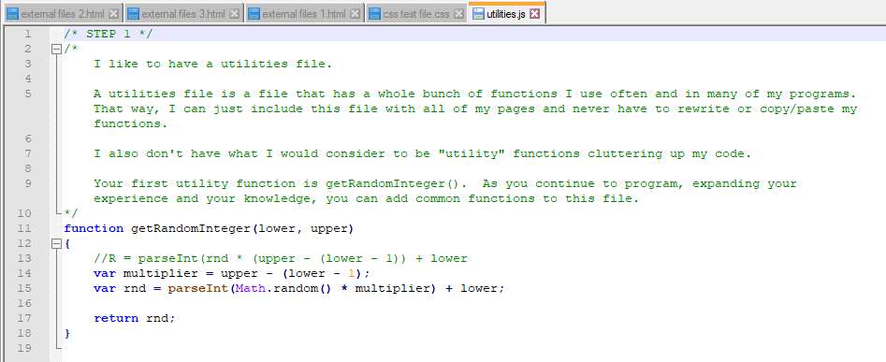
Construction

Slide 16
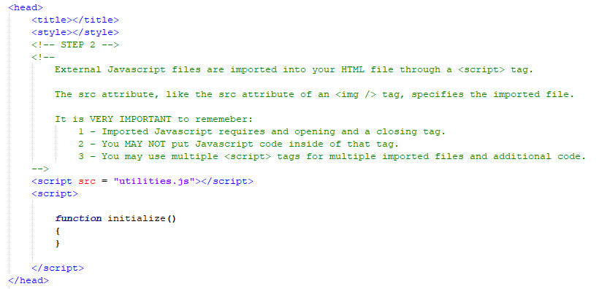
Construction
Back in index.html

Slide 17
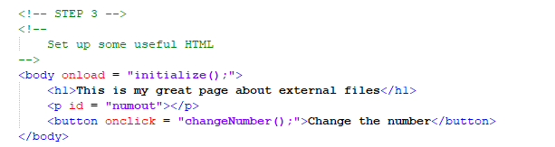
Construction

Slide 18
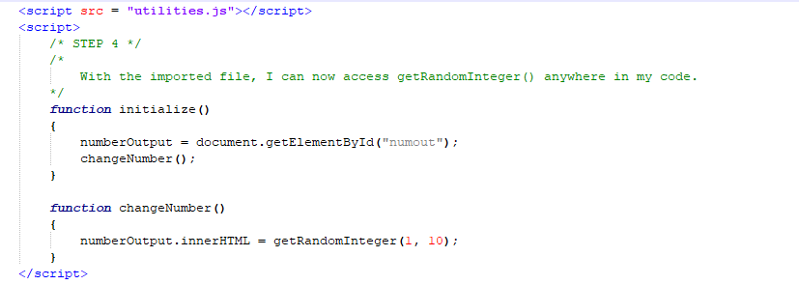
Construction

Slide 19
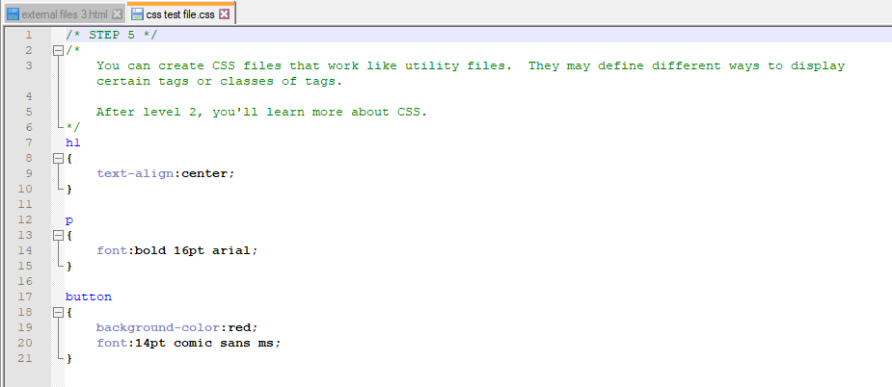
Construction

Slide 20
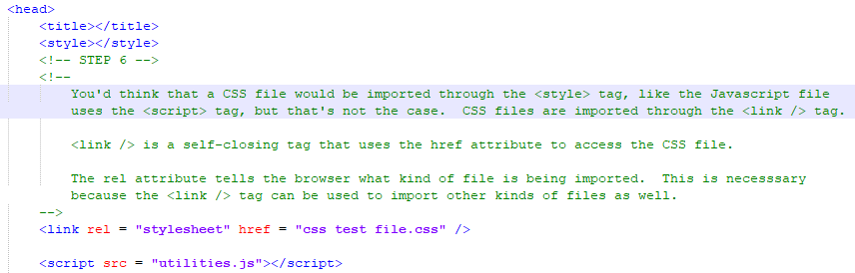
Construction
Back in index.html

Slide 21
A DEEPER MEANING

Slide 22
A Deeper Meaning
At some point over the course of the evolution of this industry, someone said, “Hey. I already did this.” and didn’t want to do it again. So, that person, or someone else in the same boat, came up with modular programming. Modular programming means you’re writing code that is portable. It’s something that can be useful on a variety of projects and that creates efficiency in a lot of ways.

Slide 23
A Deeper Meaning
You don’t have to write new code to do something you’ve already done.

Slide 24
A Deeper Meaning
You don’t have to retest that code.

Slide 25
A Deeper Meaning
You do have to test the way your new code might interact with it, but if there’s a problem, it’s easier to nail down because it’s got to be the new code.

Slide 26
A Deeper Meaning
Modular code led to engines. An engine is code that performs functions on a very basic level. When you write a program, you take its engine, and build your specifics on top of it. If anyone’s ever told you not to reinvent the wheel, that person was talking about engines. Why spend weeks or months or even years writing a whole lot of complicated code when someone’s already done it?

Slide 27
A Deeper Meaning
Disclaimer: This doesn’t mean that you should be stealing your project solutions from the internet. It means you can use tools that already exist to solve the problems assigned to you.

Slide 28
FAQ

Slide 29
FAQ
If I find the solution to a project or activity online, can I just use that?
  Um….no. That’s cheating.

Slide 30
ACTIVITY

Slide 31
utilities.js
Take the utilities file from the construction and put it in a safe place. You should include it with each project. Every time you discover a function that you’ve been using over multiple projects, add it to the utilities file.

